Slide 1
Improving SVM Accuracy on MNIST through Hyper Parameter Tuning and Feature Engineering
Submitted by:
Ayesha Ahmad 2021-EE-052
Aina Shafqat 2021-EE-058
Submitted to:
Dr. Irafan Ullah Chaudhry

Slide 2

Introduction/Motivation
MNIST Dataset:
60,000 training and 10,000 testing handwritten digit images.
Each image is a 28x28 grayscale pixel grid, providing 784 features.
Motivation:
MNIST serves as a benchmark dataset, allowing for comparison and evaluation of algorithms in digit classification.
Handwritten digit classification presents challenges such as variations in writing styles and noise.
Objective:
Explore fundamental ML concepts: feature engineering, hyper-parameter tuning, and SVM classifiers.
Develop accurate and robust models for digit classification tasks.
Approach:
Feature Engineering: Extract and select relevant features to enhance accuracy.
Hyper-parameter Optimization: Ensure well-trained SVM models for generalization.

Slide 3
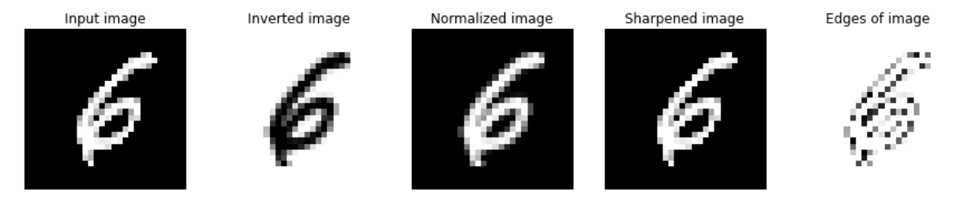
Feature Engineering Techniques
Flat Images
Inverted Colors
Normalized Images
Flat images represent the original grayscale images without any additional processing.
Inverted color images are obtained by inverting the pixel intensities, changing white to black and vice versa, and then flattening the image.
Normalizing images adjusts pixel values to a common scale, reducing the impact of variations in lighting and contrast.

Slide 4
Feature Engineering Techniques (Continued)
Image Edges
Sharpened Images
Extracting edges from images focuses on the boundaries between black and white.
Sharpened images undergo filtering to enhance edges and details, improving the contrast between adjacent pixels.

Slide 5
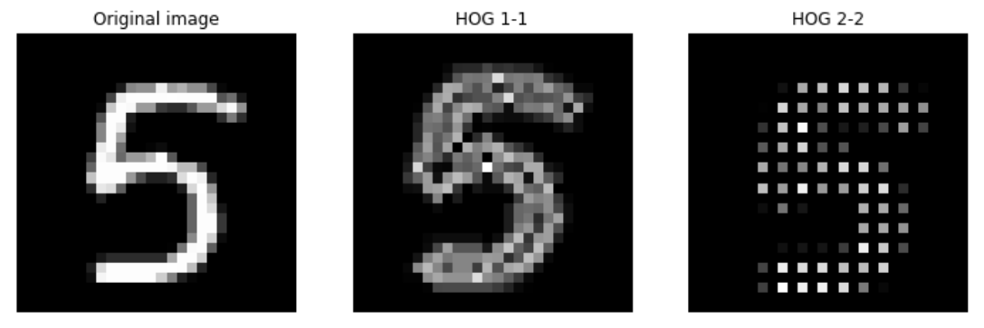
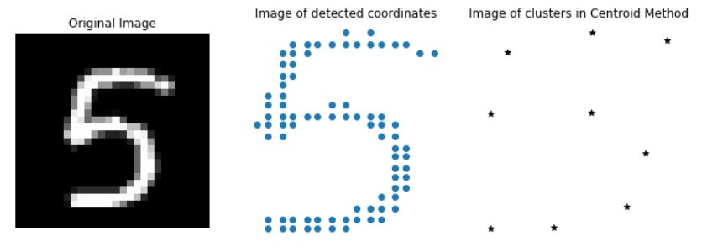
Feature Engineering Techniques (Continued)
HOG and SIFT
Centroids
HOG (Histogram of Oriented Gradients) and SIFT (Scale-Invariant Feature Transform) are powerful feature extraction techniques that capture local gradients and distinctive local features.
Centroids are representative points that mark the centers of clusters obtained through clustering algorithms like K-means. They capture the average characteristics of the data points within each cluster.

Slide 6

Mathematical Featurization Techniques
1
Covariance Matrix
2
Eigenvalues and Vectors
3
Principal Component Analysis (PCA)
The covariance matrix represents the relationships between different pixel intensities, which can provide insights into the image's overall structure.
Eigenvalues and eigenvectors of the covariance matrix can reveal the principal components of variation in the dataset, aiding in dimensionality reduction.
PCA is a dimensionality reduction technique that transforms the original features into a lower-dimensional space while preserving the most important information.

Slide 7
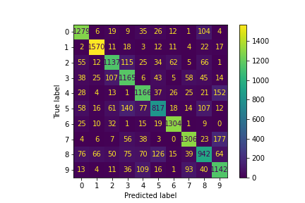
Analysis Techniques Used
Confusion Matrix Analysis
The featurized models were visualized using confusion matrices to identify the reasons for validation errors, such as the misclassification of certain digits like 5 and 8 as 3, and 9 as 4 or 7.

Slide 8
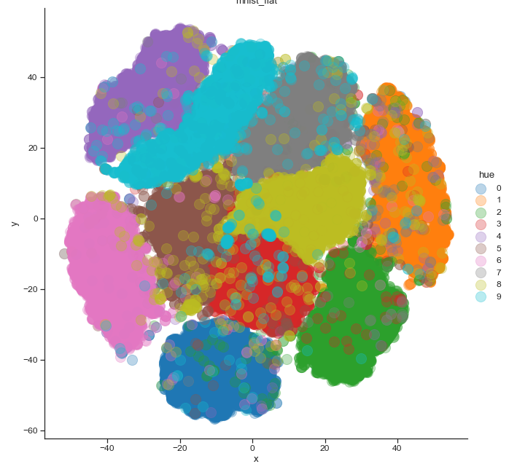
Analysis Techniques Used
tSNE Plot Analysis
The featurized models were visualized using tSNE plots. The more separable the scatters of each label, the higher the accuracy achievable is observed.

Slide 9
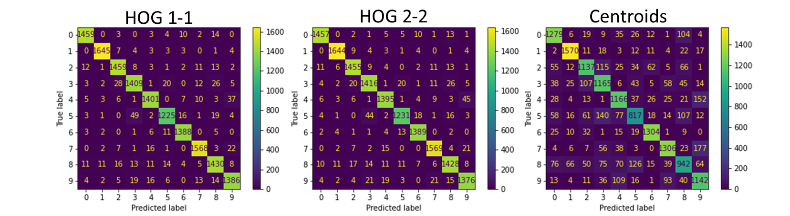
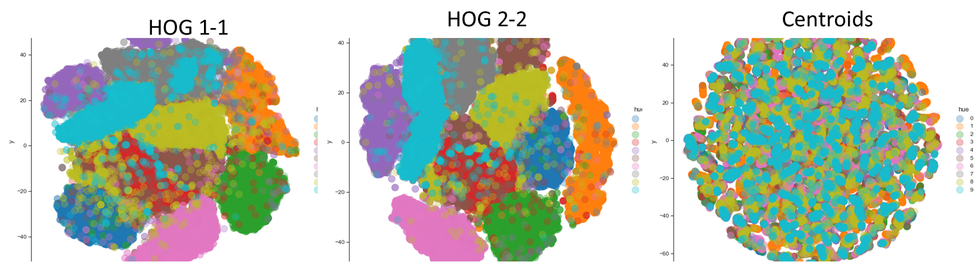
Studying Featurized Models

Slide 10
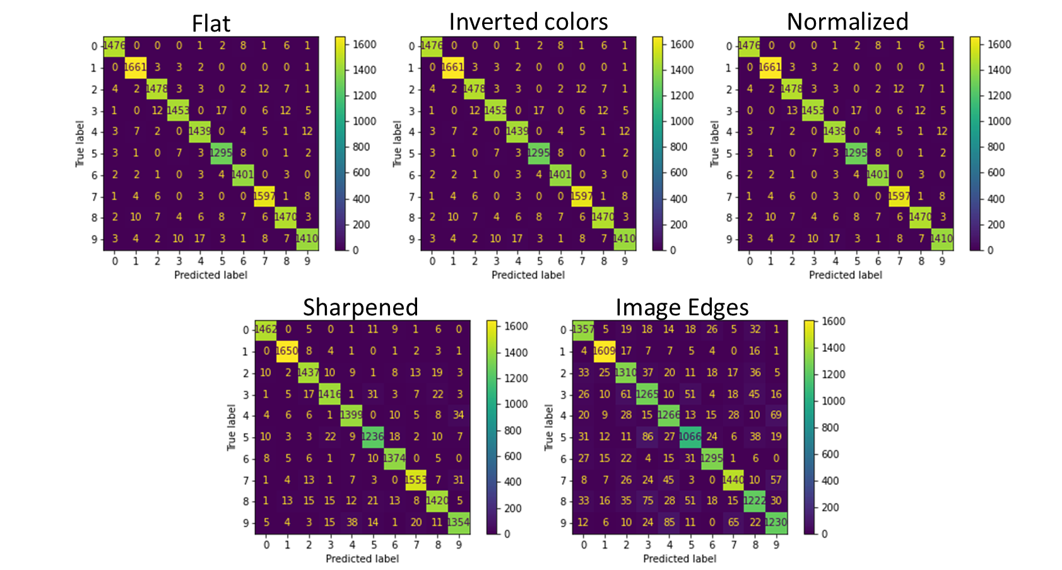
Studying Featurized Models

Slide 11
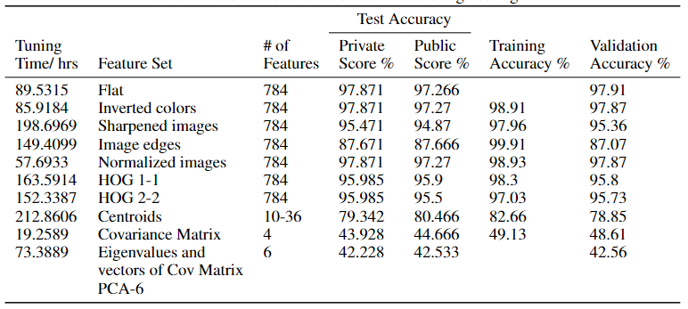
Accuracy Results

Slide 12
Conclusion
Key Findings:
This project demonstrates the effectiveness of hyper parameter tuning and feature engineering in enhancing machine learning model performance,
Rigorous optimization led to achieving a best test set accuracy of 97.871% on the MNIST dataset.
Challenges and Limitations:
Extended training times for certain feature sets pose challenges due to computational resources and time constraints, for example for the Centroids feature set the tuning time was 212.8606 hours
SIFT method's variability in descriptors impacts feature extraction and classification performance.
Practical Implications:
The challenges in feature extraction methods highlight their limitations for real-world applications.
Issues with computational resources and variability in SIFT descriptors impact scalability.
Contributions to ML Field:
This project deepens understanding of ML principles and their practical applications.
Insights gained contribute to the advancement of ML techniques and their scalability in real-world scenarios.

